Slide 1
Employee Data Analysis using Excel
STUDENT NAME: K. Prithisha
REGISTER NO:312204824
DEPARTMENT:B. COM(G)
COLLEGE: Thirumurugan arts and science college for women

Slide 2
PROJECT TITLE
To analyze employee performance in Excel:
1. **Input Data**: Record metrics like tasks completed, goals met, and attendance.
2. **Use Formulas**: Apply functions like AVERAGE and STDEV to assess performance.
3. **Create Charts**: Visualize data with graphs for easier interpretation.
4. **Generate Reports**: Summarize findings in a clear format to share insights.
This process helps in tracking and evaluating employee performance efficiently.
Employee Performance Analysis using Excel

Slide 3


AGENDA
Problem Statement
Project Overview
End Users
Our Solution and Proposition
Dataset Description
Modelling Approach
Results and Discussion
Conclusion
3/21/2024 Annual Review

Slide 4

PROBLEM STATEMENT
**Problem Statement:** "An organization needs to evaluate and improve employee performance effectively. Currently, there is no standardized method for tracking performance metrics, leading to inconsistent evaluations and unclear insights into employee productivity and areas for improvement. The objective is to develop a structured approach using Excel to systematically collect, analyze, and report employee performance data, enabling more informed decision-making and targeted development initiatives."

Slide 5

PROJECT OVERVIEW
**Project Overview:**
Develop an Excel-based system to track and analyze employee performance. This includes collecting data, using formulas and charts for analysis, and creating reports to provide clear insights and recommendations for improving employee productivity and development.

Slide 6

WHO ARE THE END USERS? *Employees *Employer *Manager *Human resource (HR) *Customers *Client *Team leaders *Organizations

Slide 7

OUR SOLUTION AND ITS VALUE PROPOSITION conditional Formatting -Mission Data on Exit Date Formula -IFS(Z8>="VERY HIGH " Z8>="HIGH", Z8>="MED"TRUE"LOW") Pivot Table-Graph Bar chart-Final Output

Slide 8
Dataset Description Employee Data -Kaggle 26Features 9 Features Empl ID-Numeric First Name Last Name Performance Business

Slide 9

THE "WOW" IN OUR SOLUTION Our Excel-based performance analysis system not only provides detailed, real-time insights into employee productivity but also offers dynamic visualizations decisions and drive targeted improvements efficiently.
3/21/2024 Annual Review
9

Slide 10
MODELLING
Summary
Pivot Table
Visualization
Bar Chart
10

Slide 11
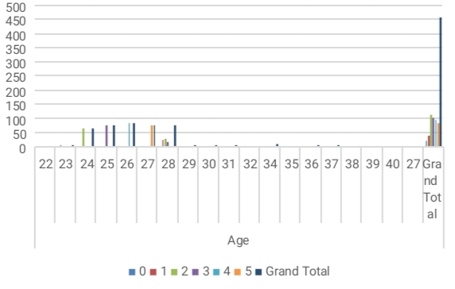
RESULTS
11

Slide 12
conclusion The conclusion of the project is that the MSC team of employees having the very High performance Level

